Slide 1



SKYPE
A hidden OSINT goldmine

Slide 2

About me
Passionate with OSINT
Twitter: White Hat Inspector @whinspector
#DailyOSINT
Creator of emailGuesser OSINT tool (https://github.com/WhiteHatInspector/emailGuesser)
Owner of an OSINT blog (https://whitehatinspector.blogspot.com/)
Volunteer in NGOs that search missing persons
Second place - Silver badge on TraceLabs OSINT CTF
Loves to travel
Loves watching series. Favorite: Brooklyn 9-9!

Slide 3
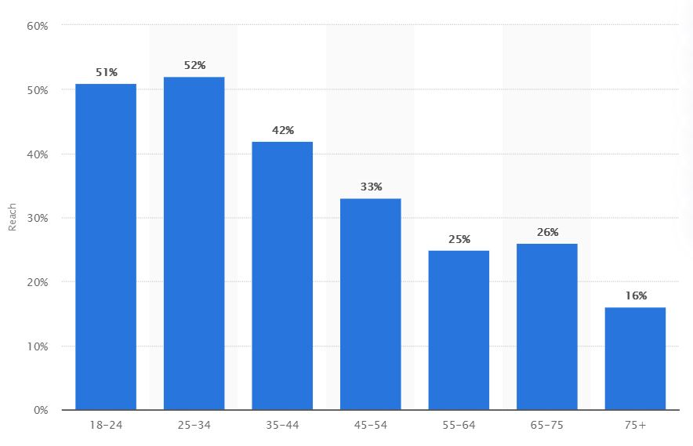
Skype
Top telecommunication/e-conferencing application
Widely spread with a vast user base
Holds 57% of global usage share across six top major platforms for e-conferencing
For US only (2018) → 50% in ages 16-44
Estimated forecast: 2.4 billion users in 2024

Slide 4
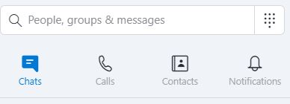
Skype search capabilities
Name (e.g. John Smith)
Username (e.g. dragon32)
E-mail address (e.g. jsmith@yahoo.com)
Telephone number
Full results even if NOT friends with the target!

Slide 5
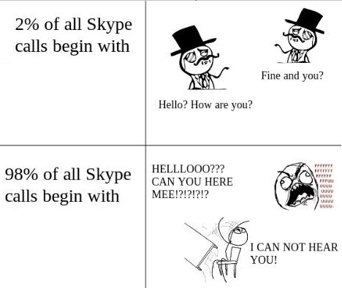
Skype
Web app version → https://web.skype.com/
Downloadable app version (Windows, Mac or Linux) → https://www.skype.com/en/get-skype/download-skype-for-desktop/
Mobile app version → https://www.skype.com/en/get-skype/skype-for-mobile/
Xbox (via Microsoft Store)
Skypli (https://www.skypli.com/) → No need for investigative account!
All have almost the same capabilities!
Choose what suits you best. Methodologies remain the same.

Slide 6

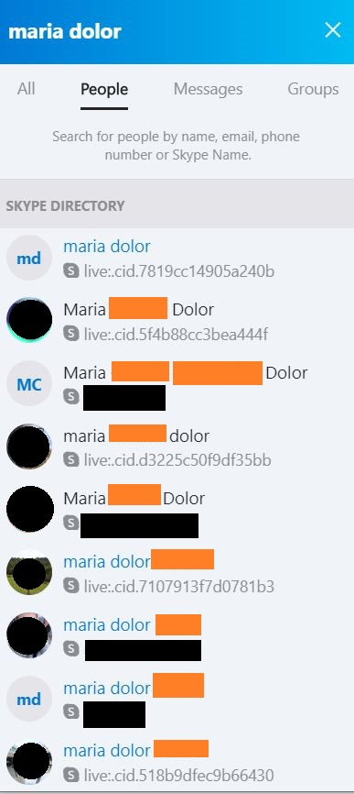
Querying Skype by name
Full Name (first + last or vice versa)
Partial names or surnames that reveal middle names!
Not always (Display name = Real name) although often
Display name (can be modified) ≠ Skype username

Slide 7

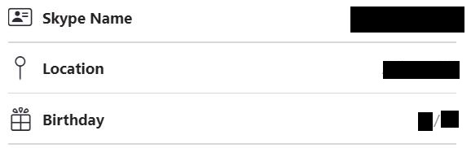
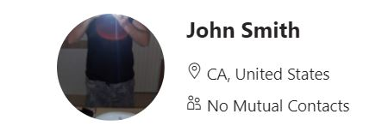
Profile information
With a (partial or full) name we may have:
Full name (middle or surname previously unknown)
Username
Present/future place of residence
Birth date (and year…)
Profile image
Download or reverse search:
https://avatar.skype.com/v1/avatars/username/public
No exif data ☹
Same apply to all kind of queries!

Slide 8
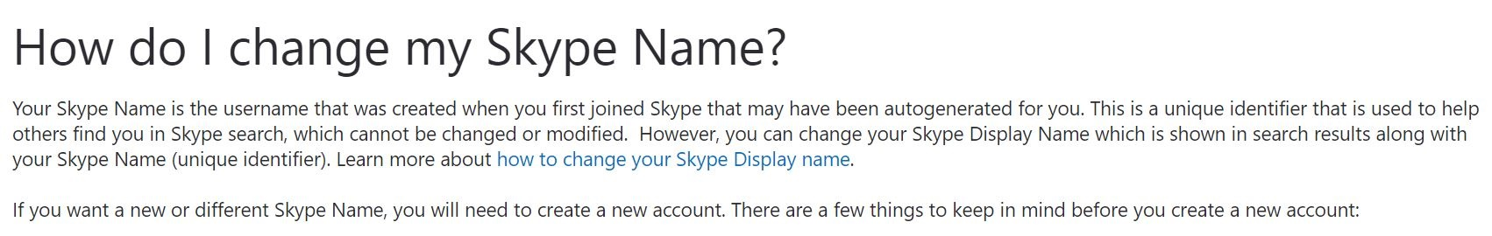
Revealing hidden information: Skype usernames
According to Skype:
1. The user’s Skype username is autogenerated by Skype (user cannot create/select it himself) during account creation
2. A user can never change/modify his username
3. If a user wants to change his username, he must create a new account
4. If a user deletes his account, his Microsoft account is also deleted (thus discouraging people to do so)
Skype Names = Skype usernames

Slide 9
Revealing hidden information: Skype usernames
Skype ID (username) according to profile age and type:
Account creation before around 2016 → w/e ID you wanted yourself
Account creation after around 2016:
e-mail to register → live:{username of your e-mail} (e.g. live:j.smith)
telephone number to register → live:{random hexadecimal pseudo-number} (e.g. live:548ed345f547865)
Account creation after late 2019 → live:.cid.{random hexadecimal pseudo-number} (e.g. live:.cid.548ed345f547865)
Why does that matter anyway? OSINT verification purposes (e.g. age of smith2003)
2003-2016 → 13 years old
2003-2021 → 18 years old

Slide 10
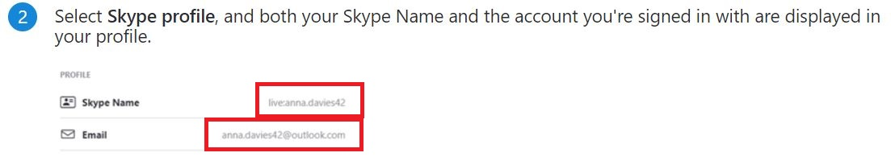
Revealing hidden information: E-mail addresses
If account creation is between 2016-2019 the e-mail address can be “guessed”!

Slide 11
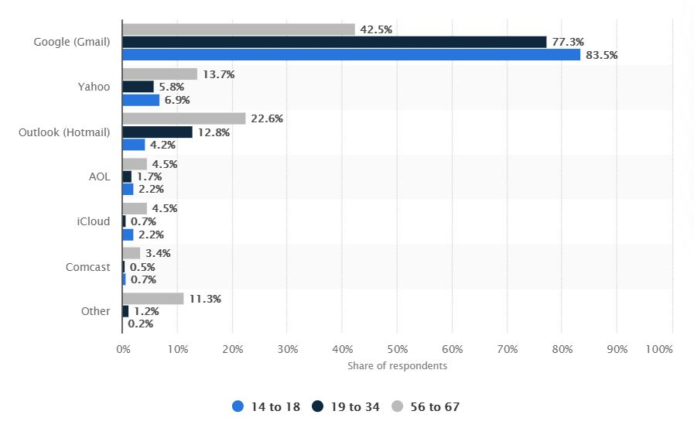
Revealing hidden information: E-mail addresses
Search commonly used e-mail addresses used in country of origin or worldwide
Search domains of his past/current job
Start ”guessing”

Slide 12
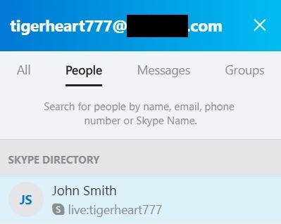

Revealing hidden information: E-mail addresses

Slide 13
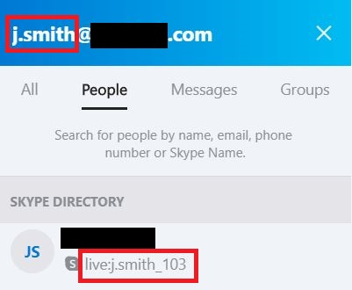
Revealing hidden information: E-mail addresses
Watch out for underscores followed by numbers!
Underscores can also be target’s input! (jsmith_1@gmail.com is very likely to exist and this is why we might see a live:jsmith_1_1 username)
Watch out for troll accounts! (e.g. live:whatever_3 or live:asdf_5)
REVERSE the process! Search for live:jsmith or live:jsmith_1 or live:jsmith_1_1 to find hidden skype profile!

Slide 14
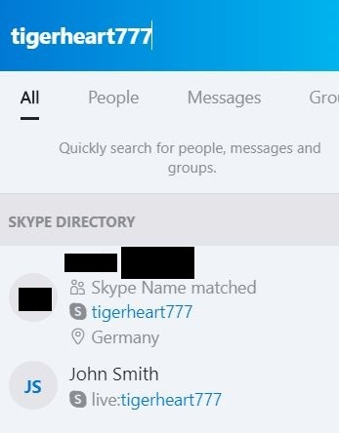
Revealing hidden information: Duplicate usernames
Duplicate username!
Expanding search to username search tools (e.g. whatsmyname, sherlock, namechk)

Slide 15
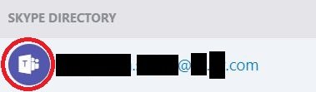
Querying Skype by e-mail address
Find display name and username
Verify e-mail address (personal/business/university)
Find hidden e-mail associations (Microsoft Teams) → especially in business/university e-mail addresses
Verify already known information
Find troll accounts (whatever@yahoo.com)

Slide 16
Querying Skype by telephone number
Find display name and username
Verify already known information
Acceptable search format: phone number search queries that include country code in +1 format and not in 001 format (e.g. +12025550117 for US)

Slide 17
Takeaways
Skype allows you to:
Find new information
“Guess” hidden information
Verify – link known information about a target
Remember: Most Skype users want to be found easily! (Professionals, gamers etc)

Slide 18
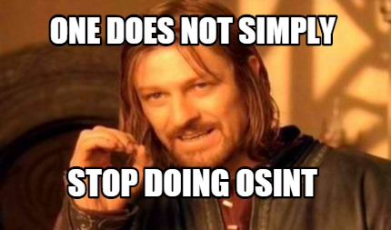
Thank you! Questions?
https://whitehatinspector.blogspot.com/2021/03/skype-hidden-osint-goldmine.html

